Slide 1
IINDPM modify process flow chart
MCU detect PD controller GPIO1 is high
(PD is SINK)
MCU read PD 0x1A register
If PD 0x1A register
bit 24-25 is 0x01
(PD controller is acting like a legacy sink)
MCU send ‘I2Cw’ command to change Charger IINDPM register 0x06 value to 0x012C (3.0A)

Slide 2
Fast charging current modify process flow chart
PD firmware loaded and set the charger default value
8.3V/3.0A
MCU detect PD controller GPIO1 is high
(attached sink)
If PD GPIO1 turn low
MCU wait 10 minutes
MCU sends ‘I2Cw’ and write to BQ register 03h (charge current) and set to 2.4A (0x00F0)

Slide 3
PDO priority sorting process flow chart 12V-->15V-->9V-->20V-->5V
MCU detect PD controller GPIO1 is high
(PD is SINK)
MCU read PD 0x1A register
If PD 0x1A register
bit 24-25 is 0x00
(PD controller is not in legacy mode)
& bit 5 is 0 (PD is in SINK role)
MCU send ‘GSrC’ command to to get adaptor Source capability
MCU read 0x30 register value to get the source capability
MCU modify 0x33 register value to change the sink requirement
MCU send ‘GSrC’ command to re-negociate PD contract

Slide 4
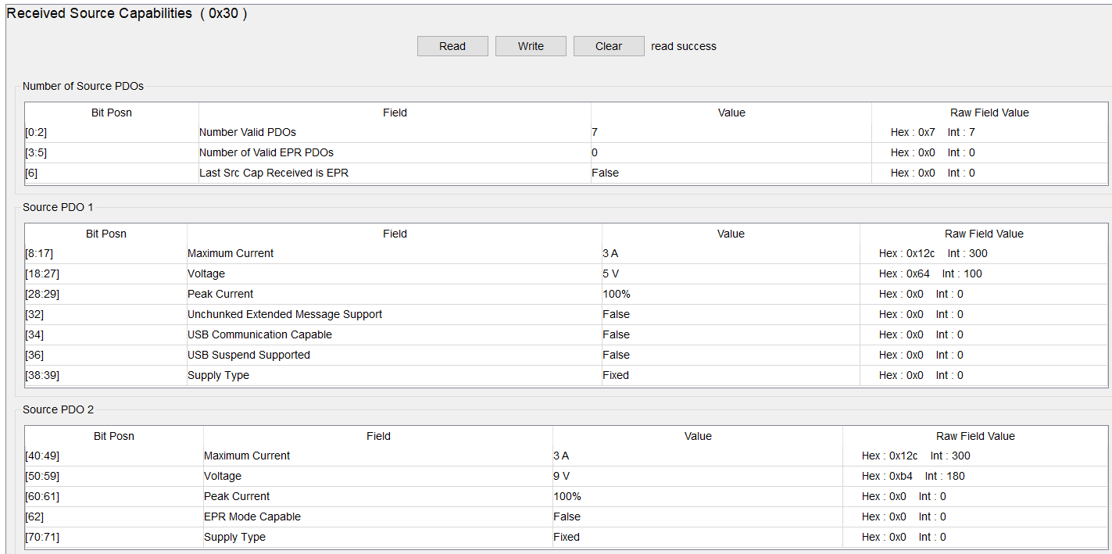
一个适配器的7 PDO数据

Slide 5
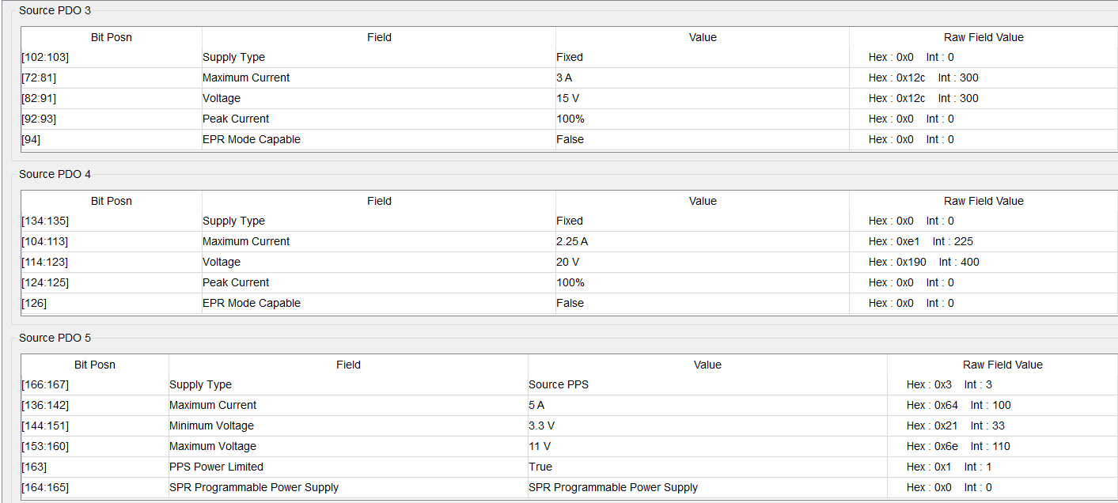
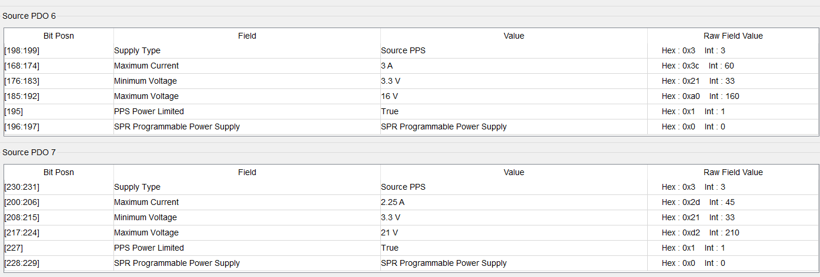

Slide 6
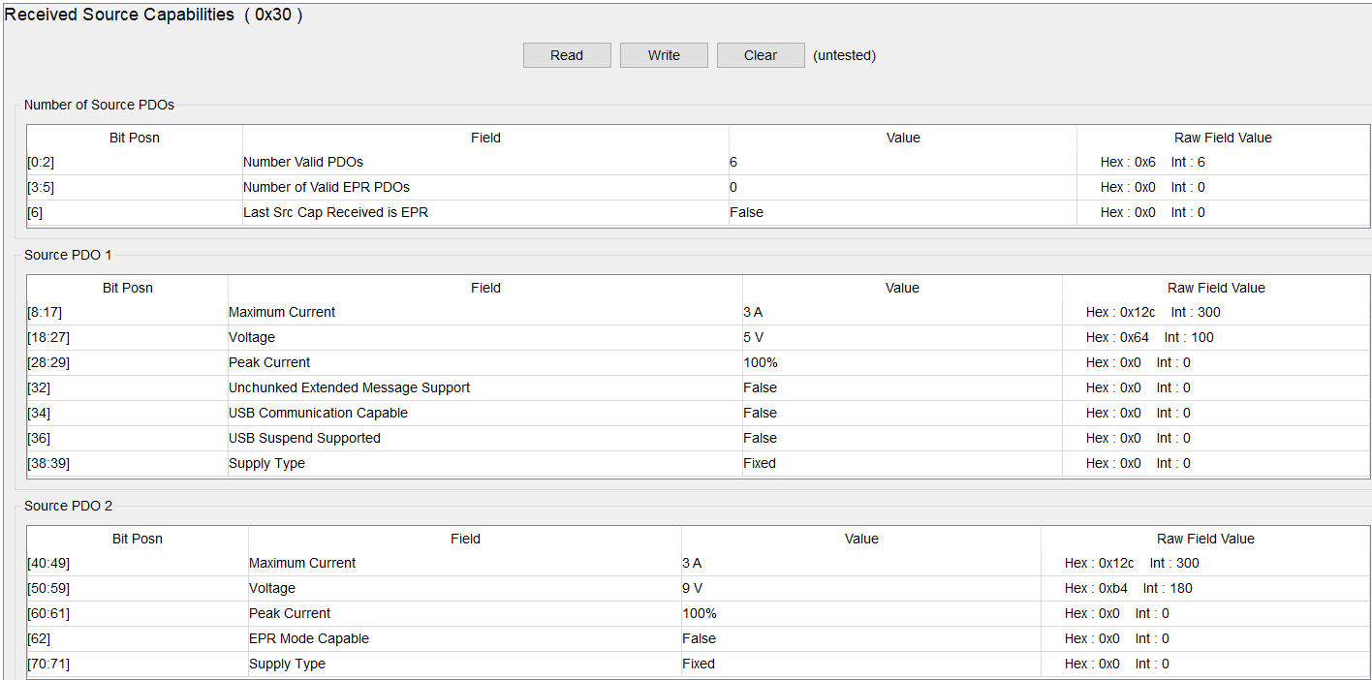
另外一个适配器的PDO数据

Slide 7
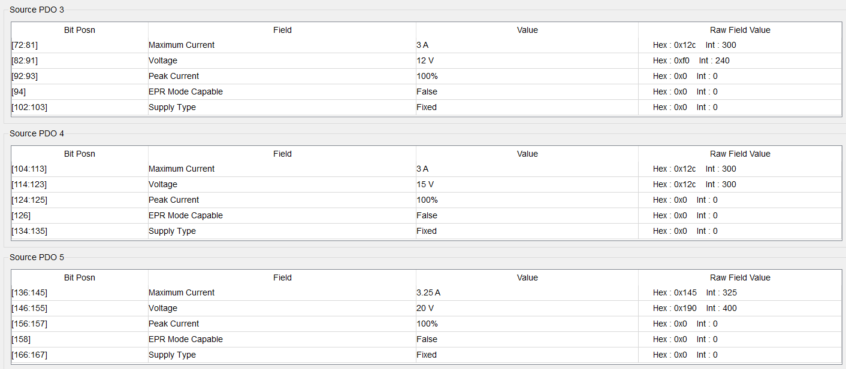
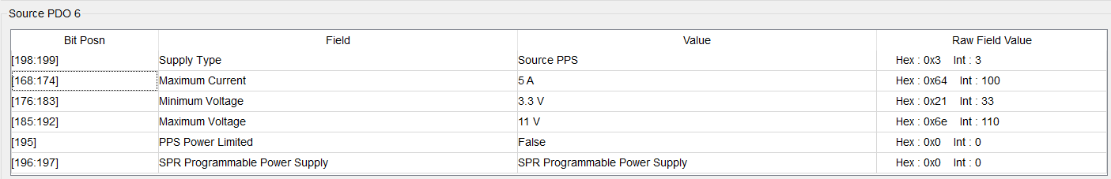

Slide 8
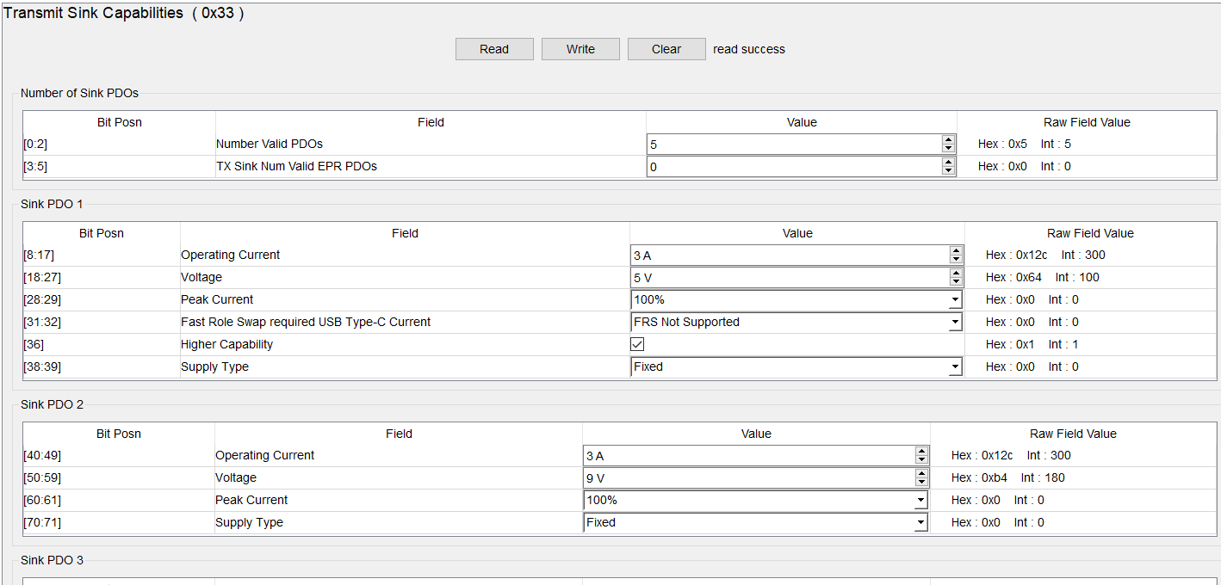
修改PDO寄存器0x33

Slide 9
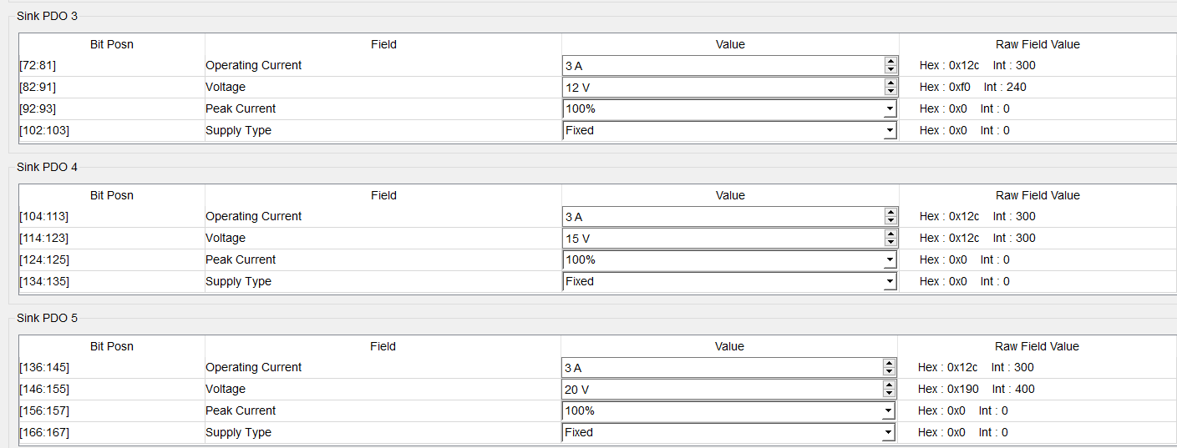

Slide 10
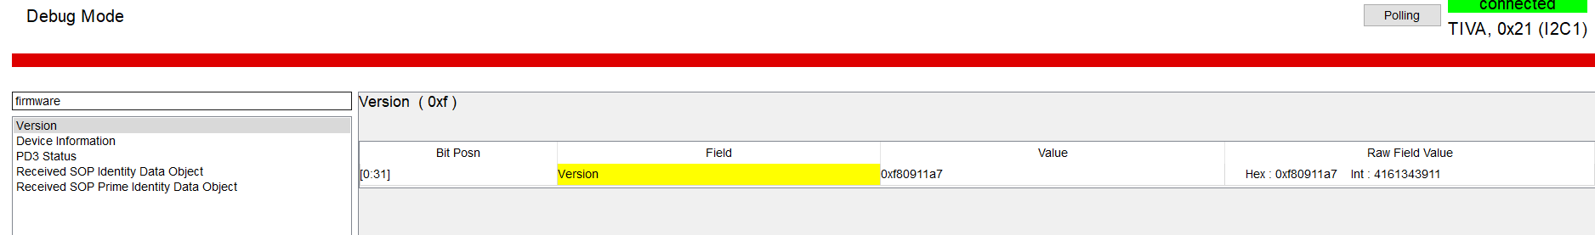
Read firmware version 0xf

Slide 11
VINDPM modify process flow chart
MCU detect PD controller GPIO1 is high
(PD is SINK)
MCU read PD 0x1A register
If PD 0x1A register
bit 24-25 is 0x00
(PD controller is not in legacy mode)
& bit 5 is 0 (PD is in SINK role)
MCU send ‘GSrC’ command to to get adaptor Source capability
MCU read 0x30 register value to get the source capability
MCU send ‘I2Cw’ command to change Charger VINDPM register 0x05 according the source capability

Slide 12
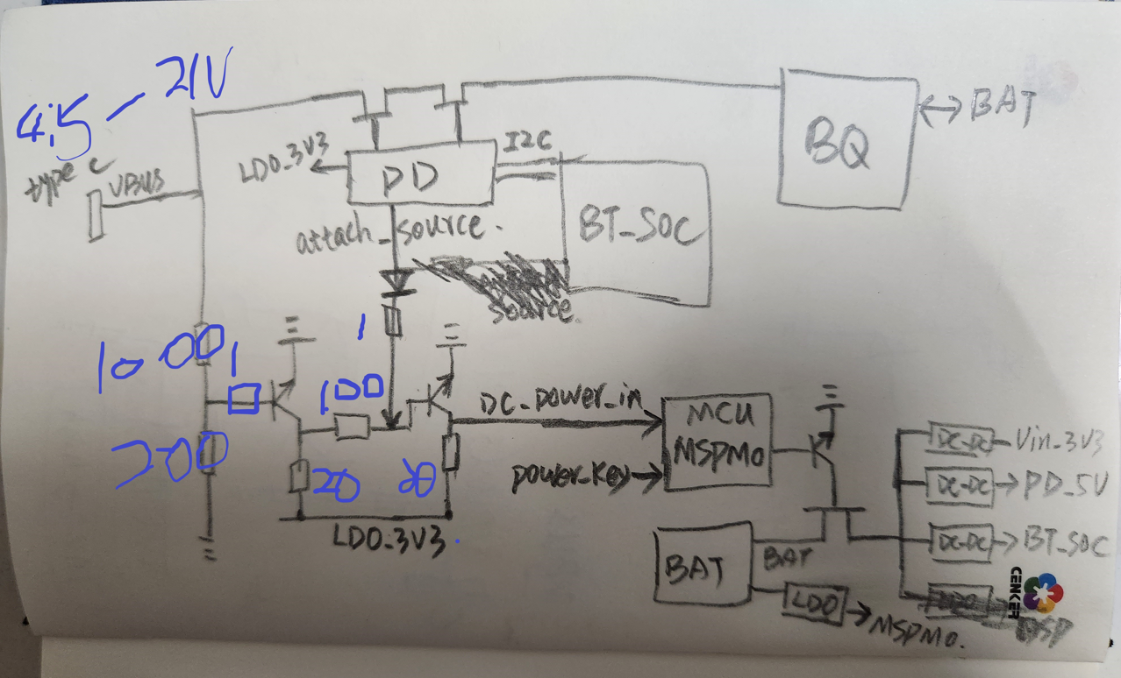












































Type C port

